Slide 1
Decoupled Access/Execute Architecture
CS252A - Eric Qu

Slide 2
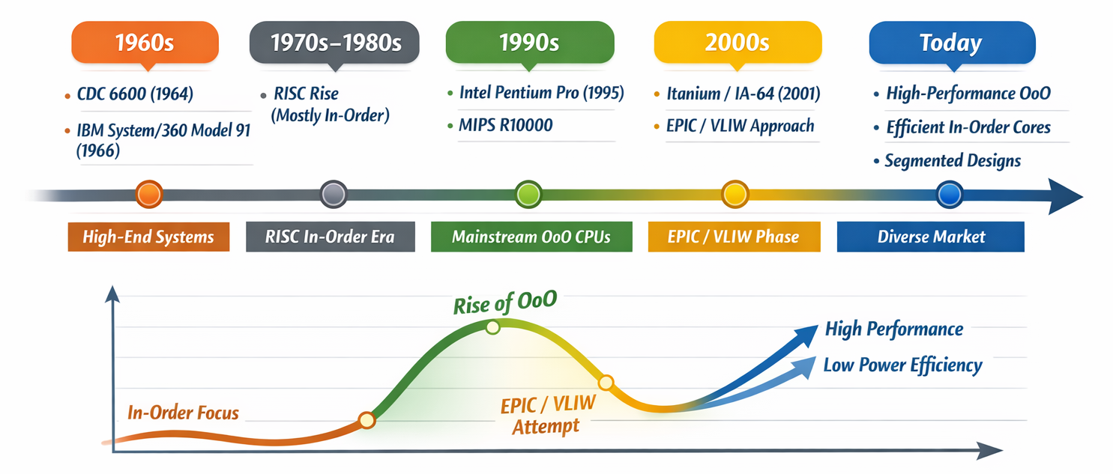
Background
It’s the early 80s
Pipelining is well established: People are struggling with Hazards
OoO is designed to help in around the 60s
  CDC 6600 (1964) Score Board; IBM 360/91 (1967) Tomasulo's algorithm
However, OoO Fades into Background
  Precise traps / Branch prediction; Expensive hardware; Simpler designs take over
Awkward spot: Instruction level parallelism open to exploit, but it's hard

Slide 3
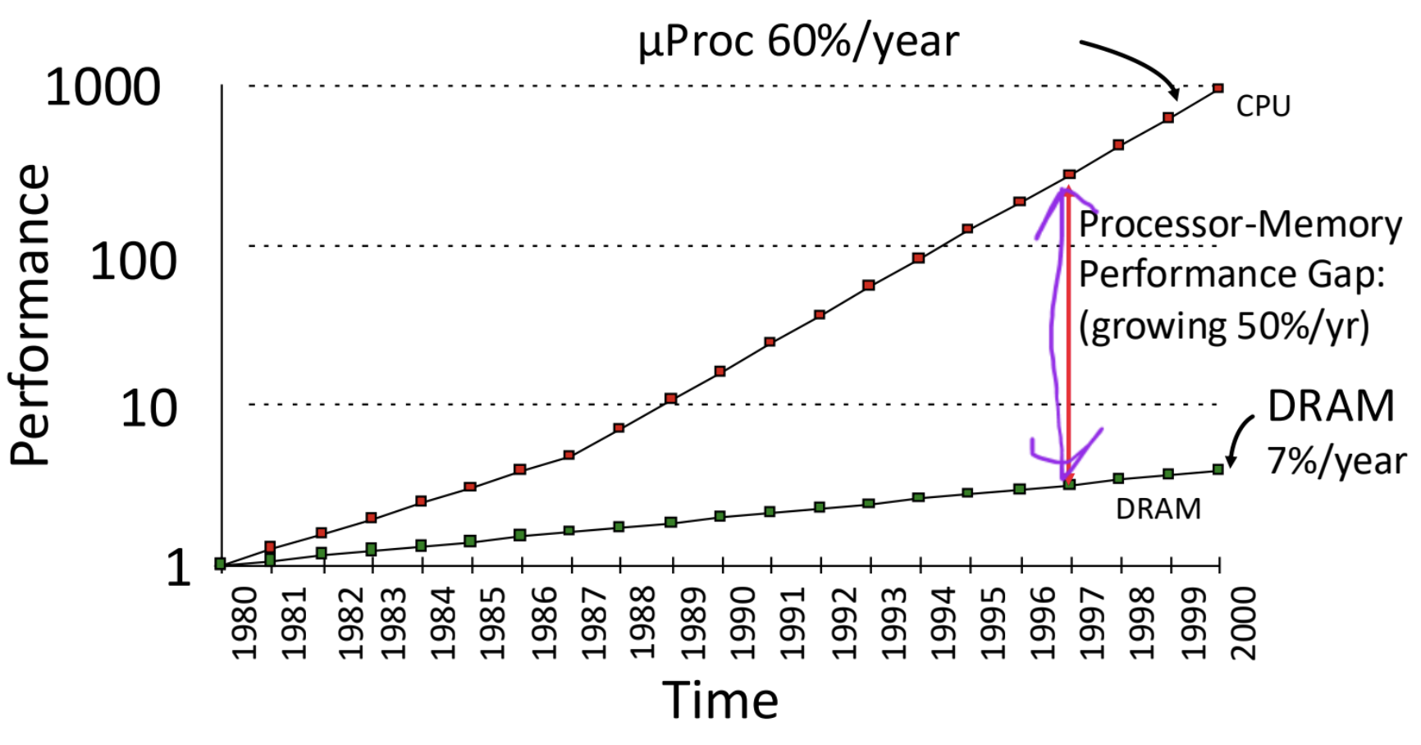
Background
It’s the early 80s
Beginning of the Memory Wall: Memory latency becomes heavier
  Hardware: Latency gap between DRAM and CPU increases
  Virtual Memory / Hierarchical Page Table: widespread in 70s, IBM System/370 (1977)
  Cache Memory: (comes with miss) IBM System/360 Model 85 (1968)
Memory latency is large, growing, and increasingly unavoidable
Any architecture that can tolerate or hide this latency has a fundamental advantage

Slide 4
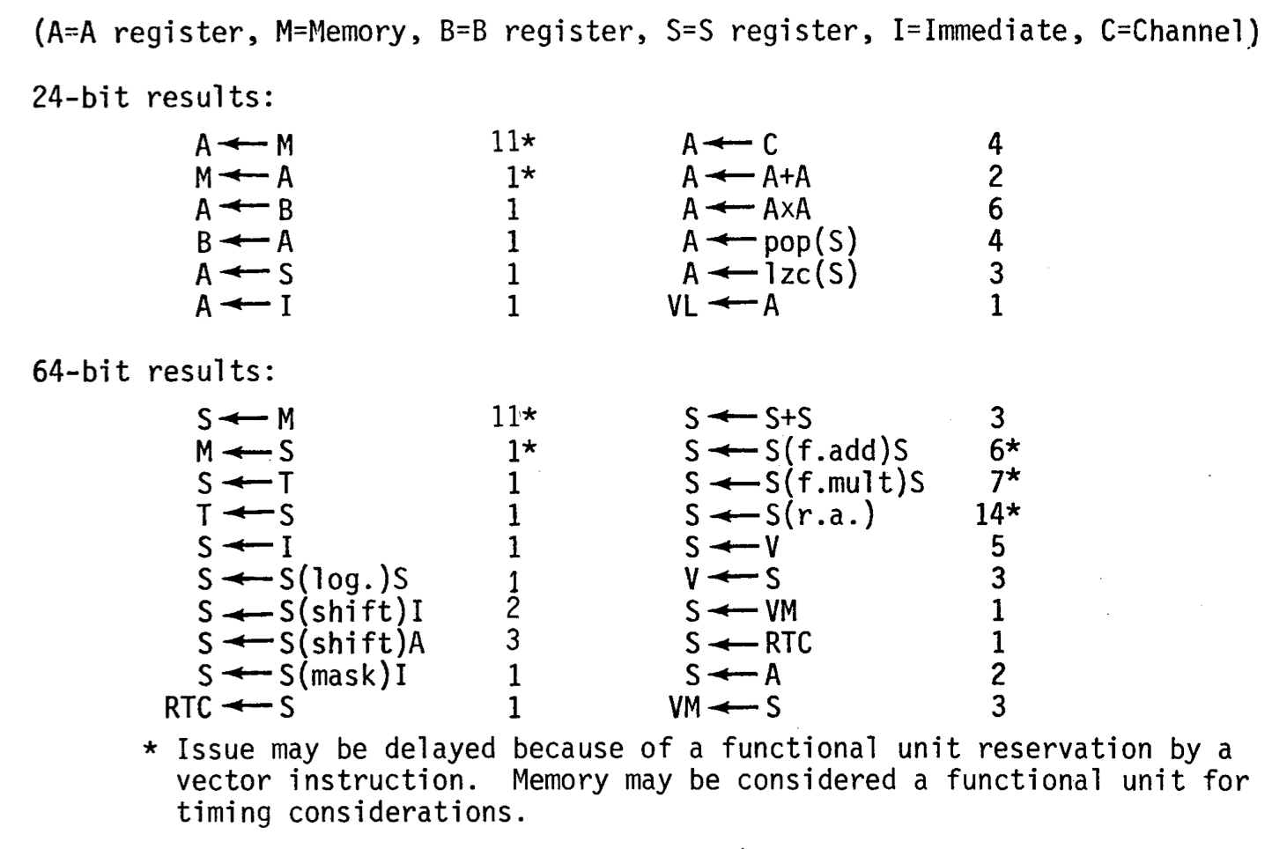
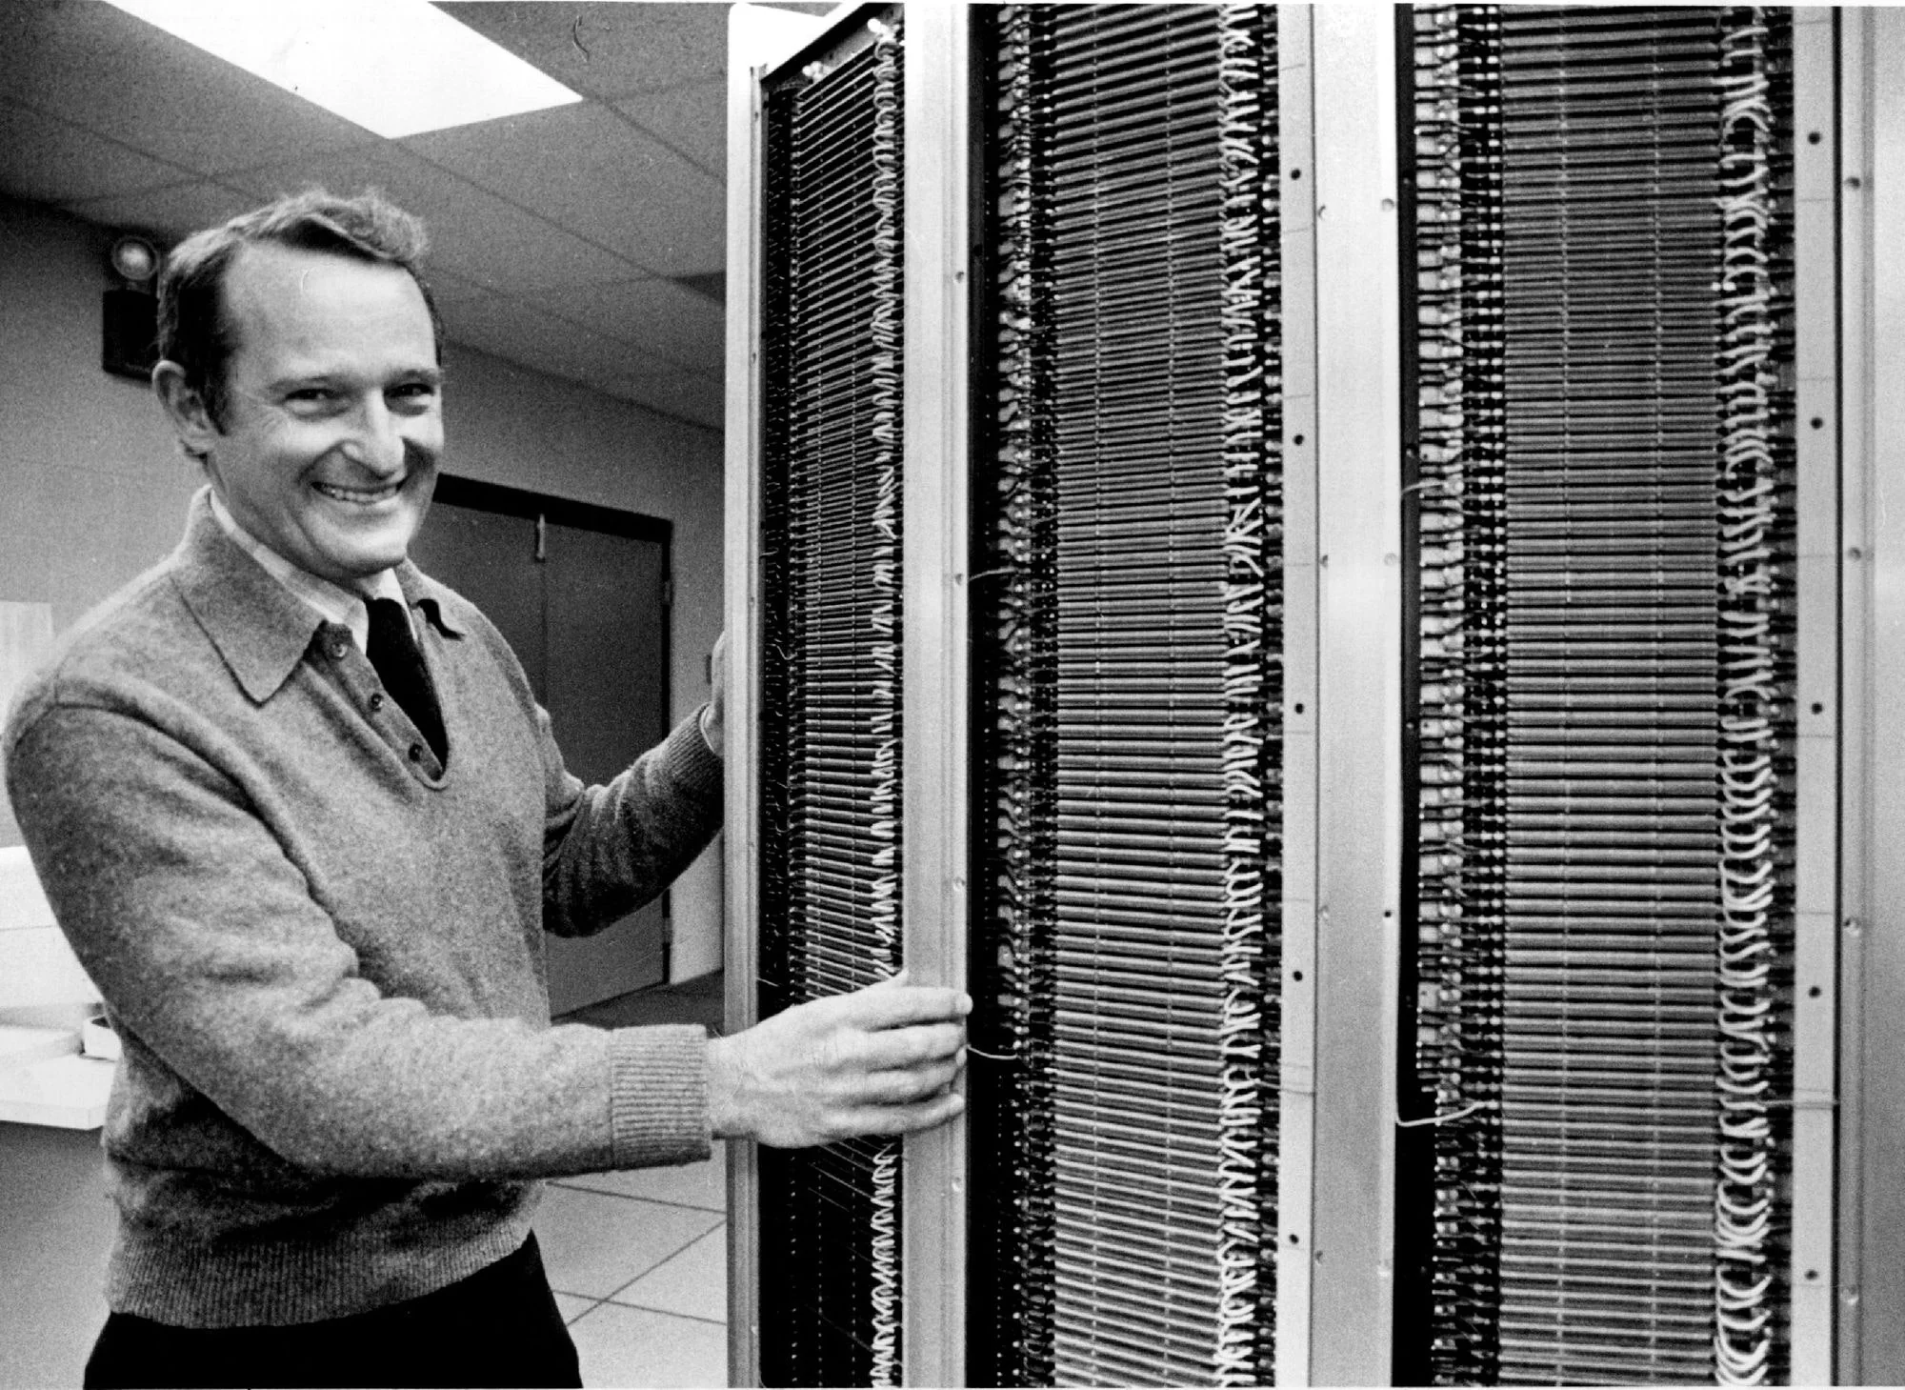
Background
It’s the early 80s
Baseline architecture: CRAY-1 (Seymour Cray, 1976) state of the art in scalar performance
Clean, pipelined design with predictable timings
No OoO: in-order issue, in-order completion

Slide 5
Background
It’s the early 80s
Baseline architecture: CRAY-1 (Seymour Cray, 1976) state of the art in scalar performance
Two register files: A registers (loads and stores, 24-bit) and S registers (arithmetic, 64-bit)
What if we push this even further?

Slide 6
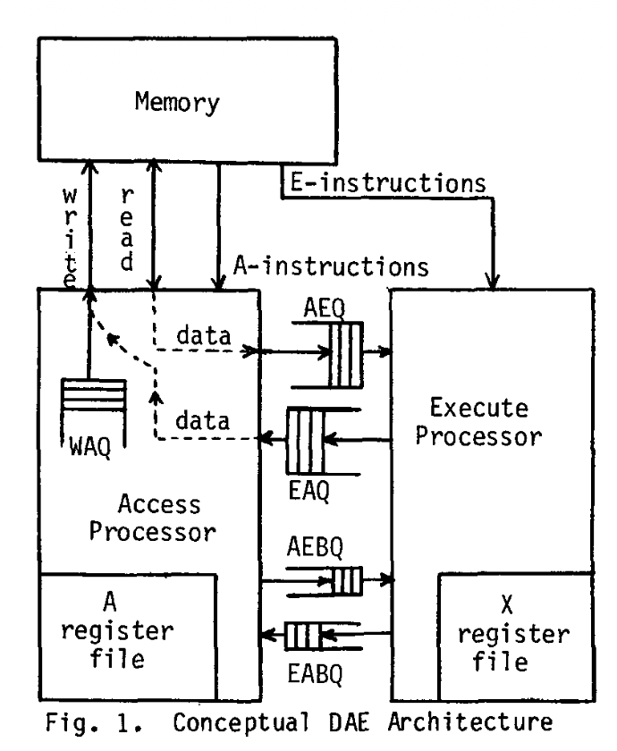
The DAE Architecture - Overview
Processor is split into two: Access and Execute
Key: Communication between A and E
FIFO queues for decoupling!
  AEQ: Fetched data from A to E
  EAQ: Computed results from E to A
  AEBQ / EABQ: handles branching
  WAQ: handles data write
Idea is similar with OoO
  A does not need to wait for E, continue fetching and fill AEQ as a buffer
As long as the queue is not empty, they don't need to wait for each other

Slide 7
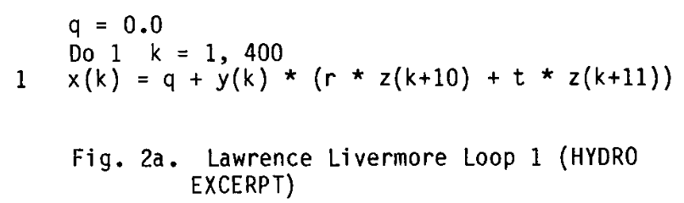
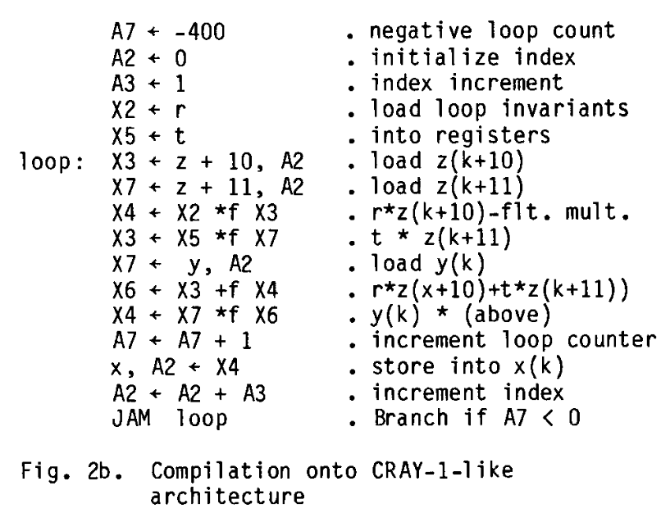
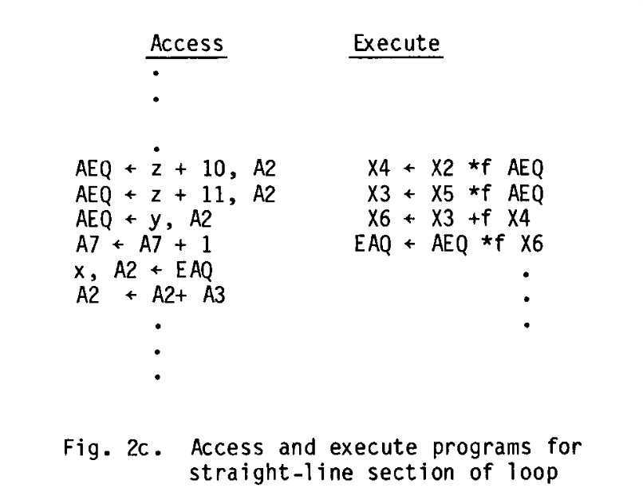
The DAE Architecture - Example

Slide 8
The DAE Architecture - Memory Write
How to write to memory?
  Naive: A compute address → (stall until) E compute data to EAQ → issue write
  This kills the decoupling!
Idea: queue the address in WAQ, and move on
  Next EAQ is automatically matched with the top of the queue
Hazard: load an address in the WAQ?
  Associatively compare every new load address against all WAQ entries
  Match? Stall until the EAQ writes
This limits the size of the WAQ to 8-16 entries
This is essentially the modern store buffer with store-to-load forwarding!

Slide 9
The DAE Architecture - Branching
Both processors have their own branch / loop
  They need to agree!
Idea: Use branching queues
  When a processor made a decision to branch, it enqueue the decision
  When the other processor reach the branching point, it will read from queue
For good performance, it is preferred to do branching on the A as much as possible

Slide 10
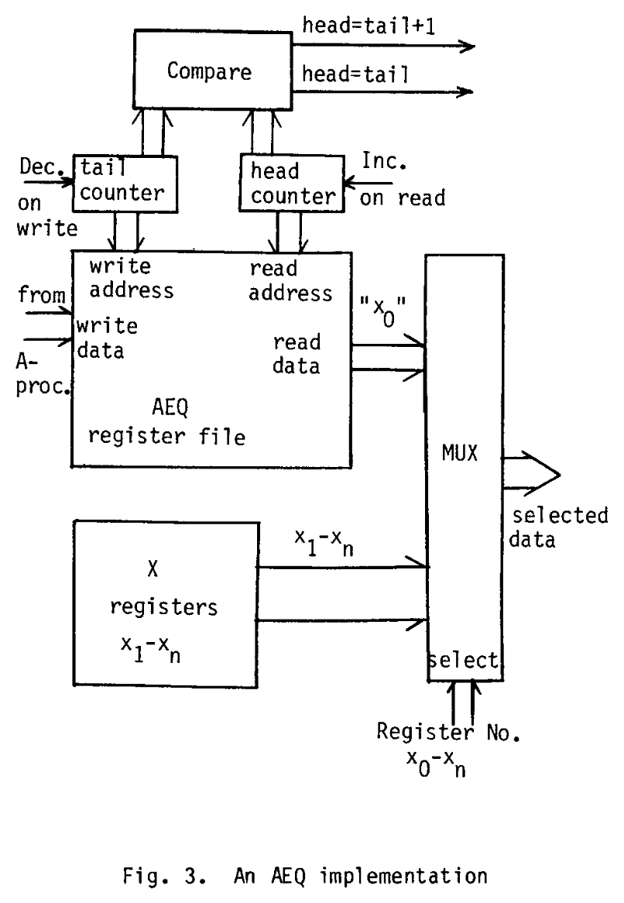
The DAE Architecture - Queue Design
FIFO Queue is used throughout
Idea: queue as register
  A0, A1, X0, X1 is reserved
  AEQ: Tail A1, Head X0
  EAQ: Tail X1, Head A0
Example: for AEQ
  For A: “A1 ← z+10, A2” both load from memory and enqueue to AEQ
  For E: “X4 ← X2 *f X0” both dequeue AEQ and do the multiply
Circular buffer register
  Head == Tail → Empty
  Head == Tail + 1 → Full

Slide 11
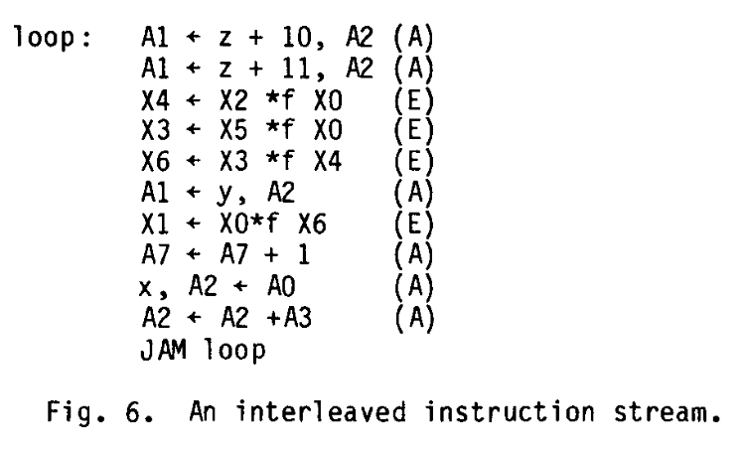
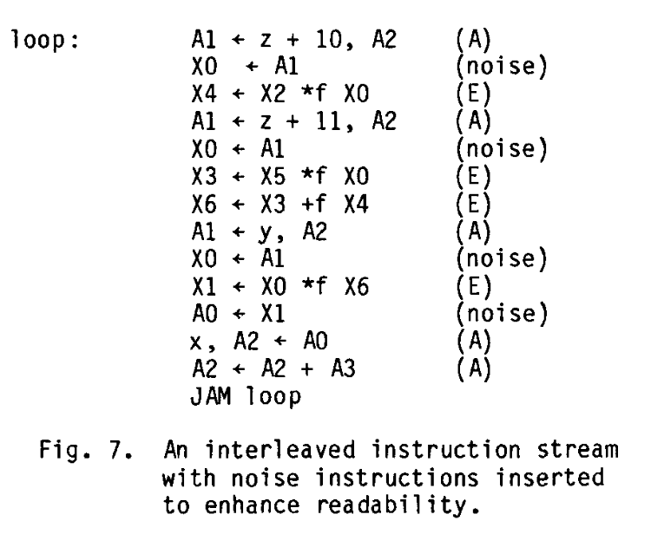
The DAE Architecture - Single Instruction Stream
It’s hard to write and compile in two instruction streams
Interleaving: Merge two stream into one with A and E interleaving
Noise instructions: explicitly write out the X0 ← A1 and A0 ← X1 instructions into the interleaving version
  This is similar to conventional program that one could directly compile
  Split into two after compile
No fundamentally new compilation technology is required

Slide 12
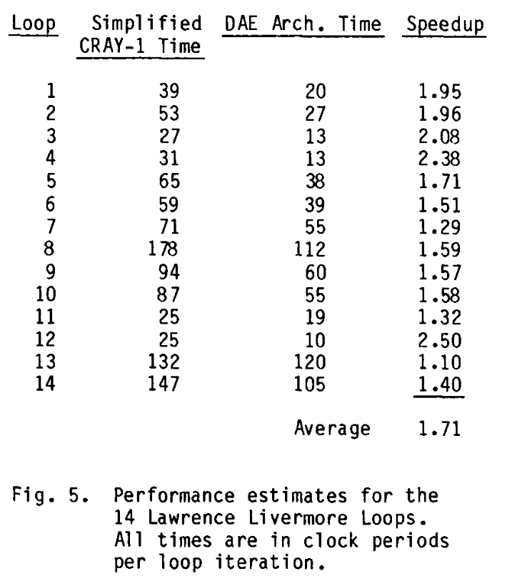
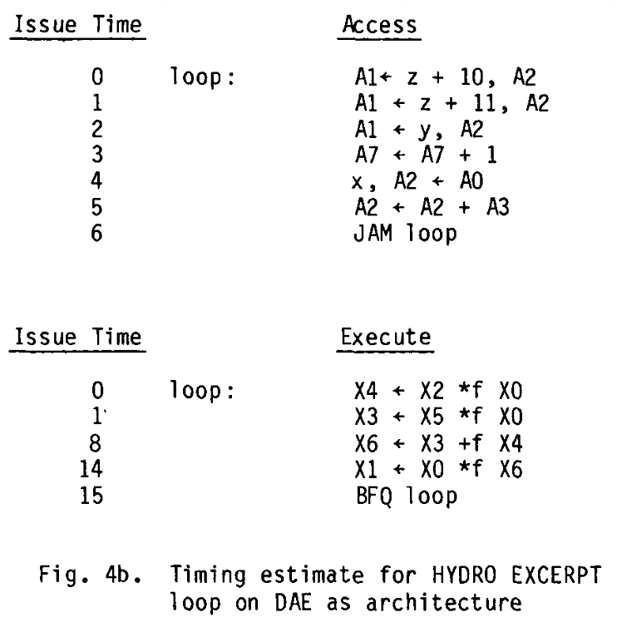
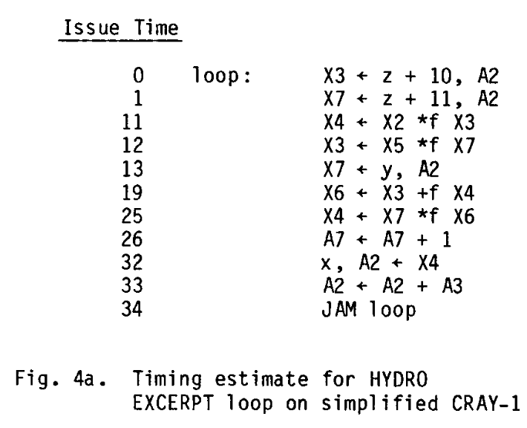
The DAE Architecture - Performance
Performance for 14 Lawrence Livermore Loops is calculated
Only theoretical, no real experiments

Slide 13
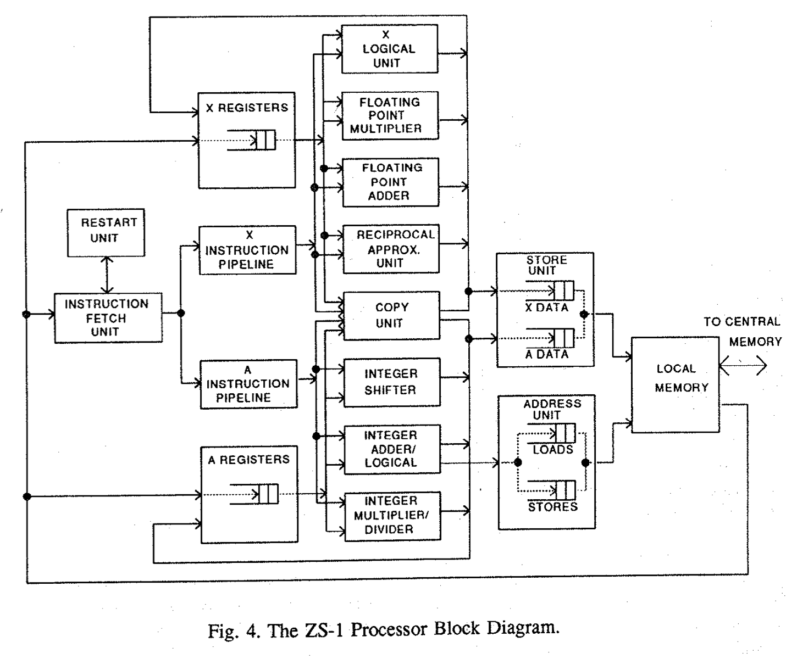
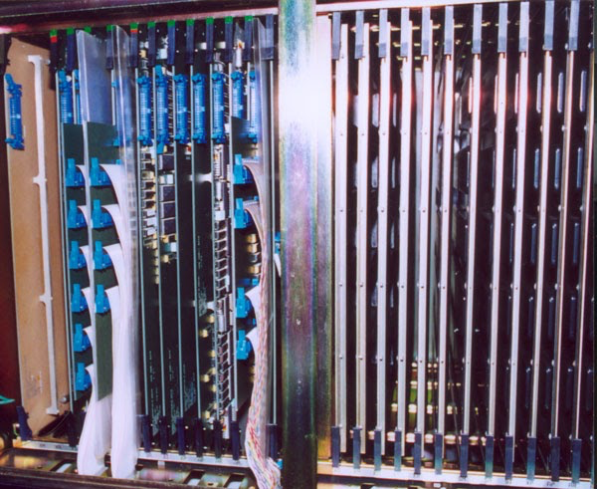
Legacy and Influence
Smith went and built it himself! The Astronautics ZS-1 is a DAE architecture
https://www.ricomputermuseum.org/collections-gallery/equipment/astronautics-zs-1

Slide 14
Legacy and Influence
Ideas similar with DAE:
Hardware prefetching
  The A processor know exactly what to fetch, hardware prefetch predict patterns
Use queues to decouple
  Instruction queues: decouple decode/issue from execute
  ROB: decouple commit from execution completion
Store buffers with address matching
  Similar with the WAQ mechanism
Remember the two problems with OoO: Branch prediction & Precise traps
Branch prediction: The A processor don’t need to predict, stalls for data-depend branches
Precise traps: Not discussed, still a problem (as far as I know)
  Interestingly, the solution (ROB), is proposed by Smith himself in 1985, 3 years later!
  Smith, J. E., & Pleszkun, A. R. (1985). Implementing precise interrupts in pipelined processors. IEEE Transactions on computers, 37(5), 562-573.

Slide 15
Questions from Reviews
How large do the queues need to be to balance producer and consumer flows?
  Queue size is not discussed, in ZS-1 Load Queue size 15, Store Queue size 7
To what extent must the compiler or programmer understand the decoupled access/execute architecture in order to generate efficient programs?
  Noise trick would make the program readable for conventional compiler
How would this compare with OoO / Prefetcher?
  OoO exploits all instruction-level parallelism, DAE is only memory and computation
  A / E could stall each other, OoO has a pool of functional units
  No speculative execution for DAE
  DAE requires separating the processors, prefetcher is relatively simple logic

